Slide 1
Welcome

Slide 2
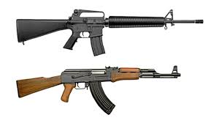
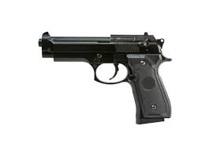
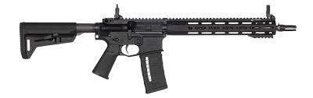
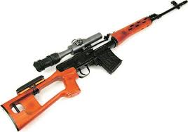
Top Side of Website
Add new
<<
>>
Gun 1
Gun 2
Gun 3
Gun 4
1.This is top side of Website where equipment are placed which are comed for maintenance
2.When clicked on that more information is displayed like what is specifications and what maintenance is done.
3.We can give slider for scrolling through equipment

Slide 3
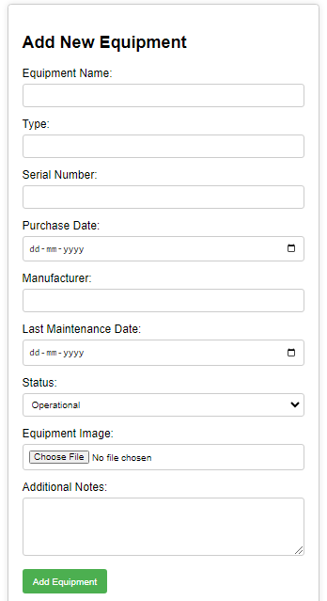

Slide 4
Add New Equipment form
1.Add New Equipment in above slide shown form for example.
2.In this form we can add Equipment name.
3.Equipment type i.e guns,Tactical gears etc.
4.We Can upload image of Equipment for visual identification.
5.Type and serial number of Equipment.
6.we can add other forms as well like maintenance check list,repair check list etc... .

Slide 5
Middle side
Specifications
---------------------------
---------------------------
----------------------------
----------------------------
----------------------------
Gun 1
Repair
maintenance
Cause 1
Cause 2
Cause 3
---------------------------
---------------------------
----------------------------

Slide 6
Thank you

